Slide 1
Have you ever been extremely irritable for no reason?
At one point felt like you have responsibilities to act like an adult but still were young enough to be treated like a child or still do?
Do you get anxious giving a presentation or taking a test in class?

Slide 2
Moods &
Adolescence
Ashley Speigle

Slide 3
What is adolescence?
Adolescence is the time period when young people begin to form a more complex self-concept and to think about their place in society.
At this age more people are trying to figure out themselves and are more susceptible to peer pressure.

Slide 4
Video
https://www.youtube.com/watch?v=MnCyma4URiE

Slide 5
What causes mood swings in teens?
The combination of sex hormones, testosterone, and oestrogen.
Not getting enough sleep also plays a big role on any person (no matter the age) when it comes to being in a good mood.

Slide 6
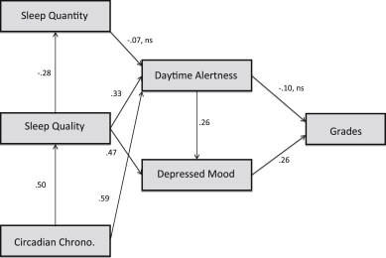
Moods & Adolescence: A Study
Studies have shown a correlation between not sleeping enough and more depressive symptoms in adolescence.
Some symptoms include:
greater irritability
lower frustration tolerance
increased variability of mood states

Slide 7
Works Cited
http://www.newsweek.com/how-teen-experiences-affect-your-brain-life-69099
Manis, Franklin R. (2015) The Dynamic Child Retrieved from https://revel.pearson.com
https://www.webmd.boots.com/children/features/teenage-mood-swings
Short, Michelle A., et al (2013). The Impact of Sleep on Adolescent Depressed Mood, Alertness and Academic Performance. Journal of Adolescence, 36(6), 1025 - 1033. Retrieved from https://www.sciencedirect.com/science/article/pii/S0140197113001139

